Slide 1






2
0
2
0
company
profile
Remal technology solutions offering end to end
solutions to the Market .
www.remal-projects.com

Slide 2


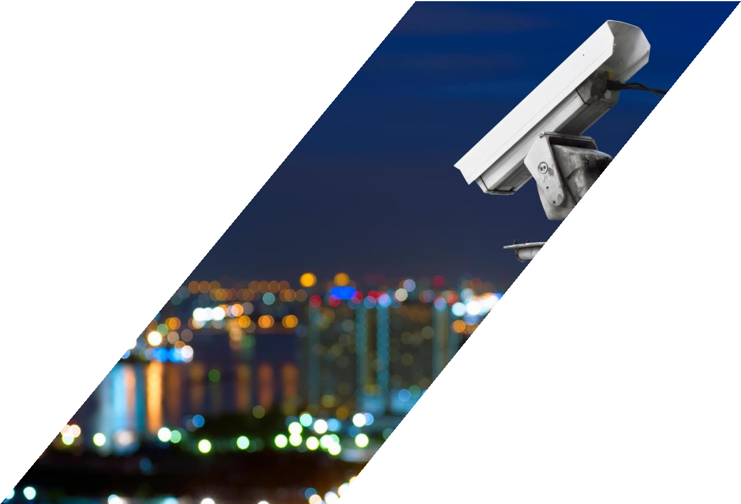




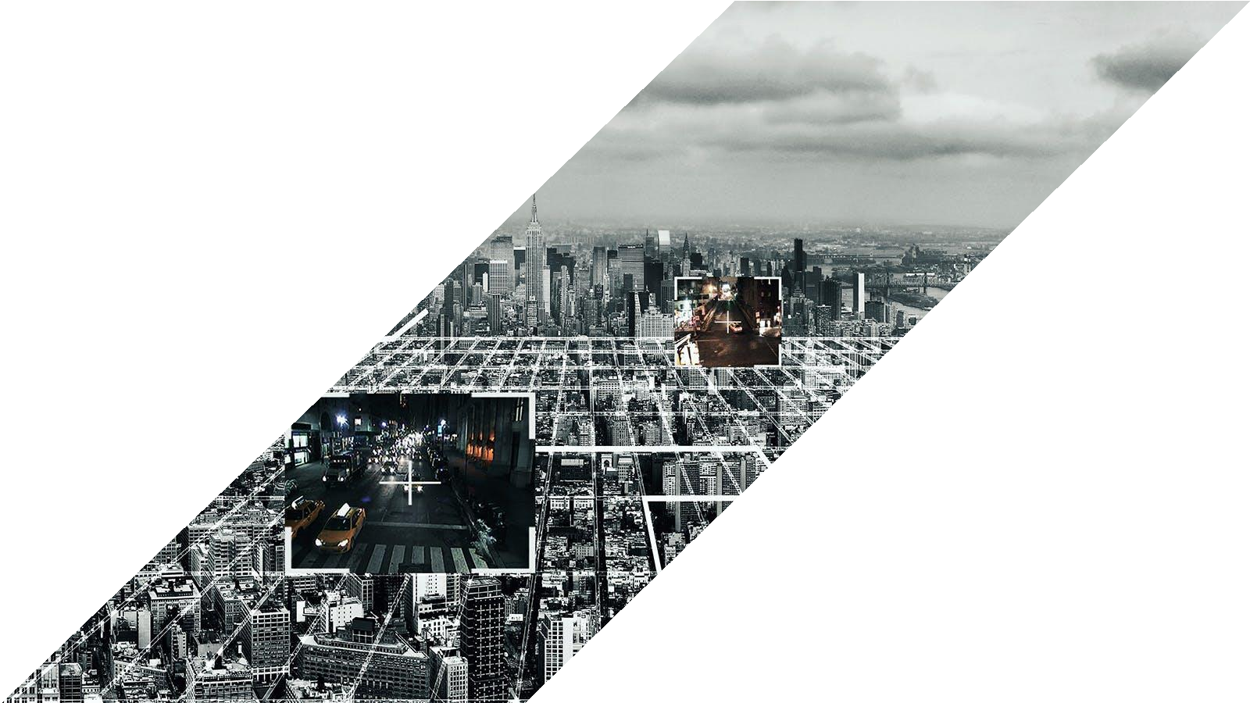
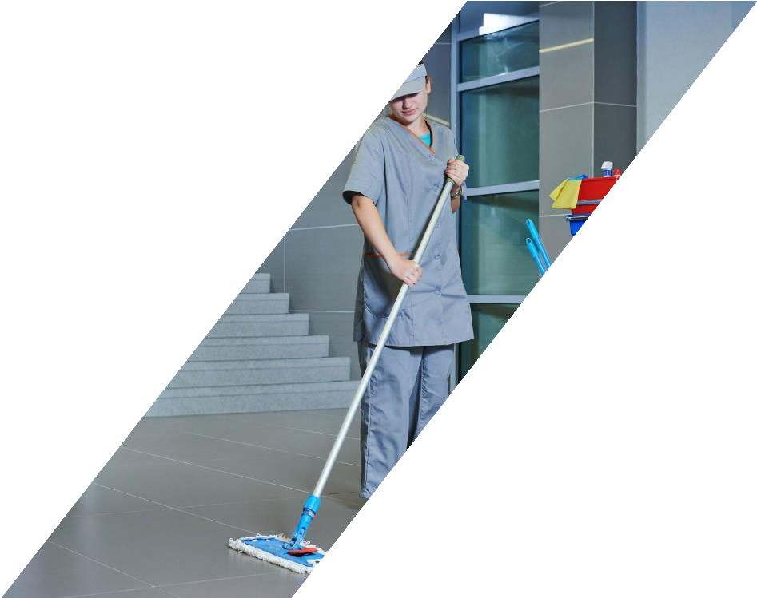
WE ARE EXPANDING EVERY DAY

Slide 3
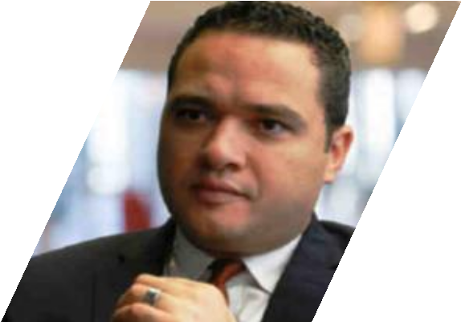
STAKEHOLDERS
Eng. Ahmed Mokhtar CEO
Our Chief Executive Officer provides the mandate and leadership for the Executive Team to work in partnership across our operational groups; he leads and implements continuous improvements in business processes and ensuring delivery of customer centric services.

Slide 4

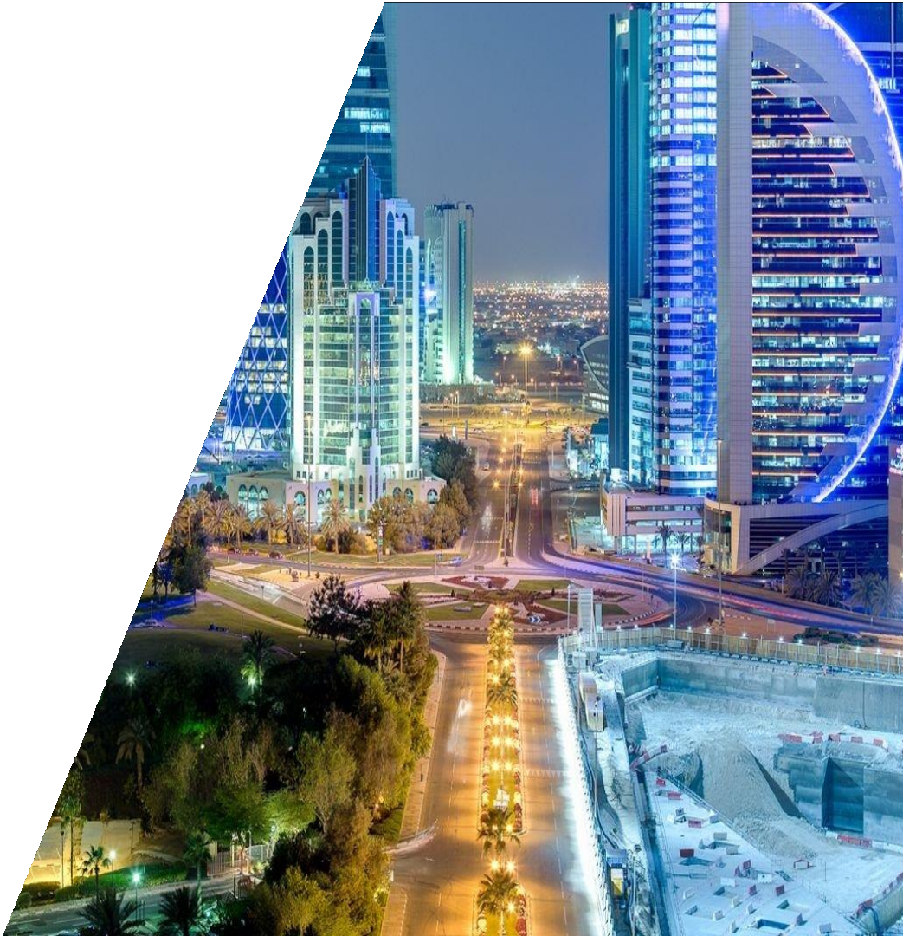
BRIEF INTRODUCTION
With more than 4 Years of experience in lighting and ELV. Remal technology solutions is offering end to end solutions to the Market .
Partnering with the leading Vendors in the field we have successfully Implemented many projects in Egypt.

Slide 5

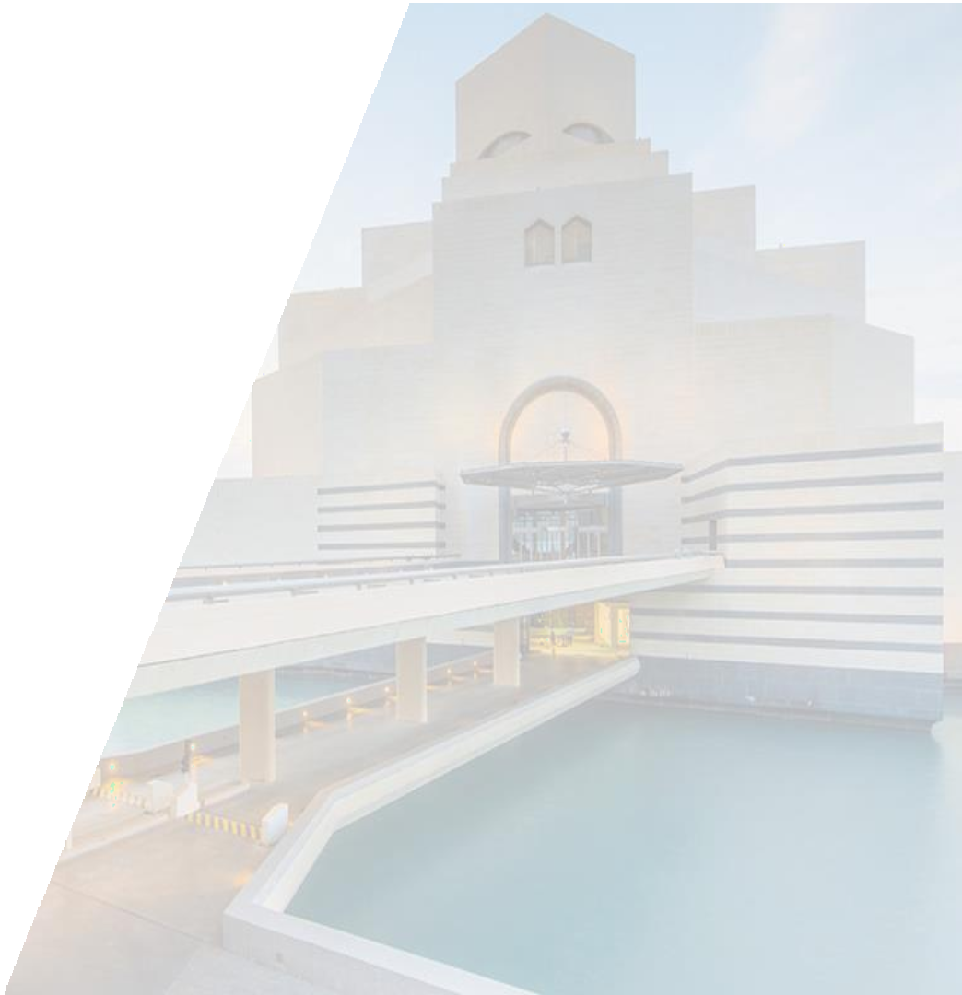









WE ARE EXPANDING EVERY DAY
COMPANY TIMELINE
Remal Security has been established to comply local authorities norms and procedures in security systems
Remal extends the reach by
opening it’s first branch outside Qatar, by introducing Remal Projects in Egypt.
Re-branding is done. This gave birth to Remal International and the journey is still on...
2011
2014
2016
2013
2015
2018
Heliopolis Technical Services was established with ELV systems as its core business.
Remal expanded its local business with establishment of Remal First Class.
Remal diversifies again and
introduces F&B to it’s wide range
of services and products
With Sweet Treats & Lab Cafe

Slide 6





MISSION, VISION &VALUES
Secure our clients from intruders and Meet Our Clients Targets & Expectations
Provide Fast, reliable solutions and
competent After Sales Support.
We are delivering unique, tailor made and cost effective solutions

Slide 7


REMAL IN FIGURES
Remal International was established in 2011 and has been active in the Qatar market as a renowned system integrator for Fire & Safety, Security, and ELV system.
More than 200 completed projects and keep on
increasing.
More that 10.000 CCTV installed.
Projects worth of 65.000.000 in 2018.
More than 400 employees that work together to fulfil
their mission and soon we will reach 500.
Solution partners from all around the world.

Slide 8




WHY REMAL?
Real, unique, tailor made and cost effective solutions.
Excellent value on time, every time.
Meet customer’s unique security requirements.
Adequate maintenance of security systems.
Leading security system partner, manufacturer and supplier.
WE ARE THE SOLUTION

Slide 9








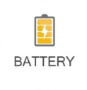
















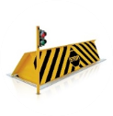


Physical Security Information System
Fire Fighting & Fire Alarm
CENTRAL BATTERY
Central Battery
CCTV SYSTEMS
PHYSICAL SECURITY INFORMATION MANAGEMENT SYSTEM
Lighting
System
SOLUTIONS
LIGHTING
SYSTEMS
MEP
ACCESS CONTROL
SYSTEMS
WE OFFER
Car Parking System
CCTV
System
CAR PARKING SYSTEMS
FIRE ALARM & FIRE FIGHTING
Physical Security System
Public address System
PHYISICAL SECURITY SYSTEMS
PUBLIC ADDRESS
SYSTEMS

Slide 10
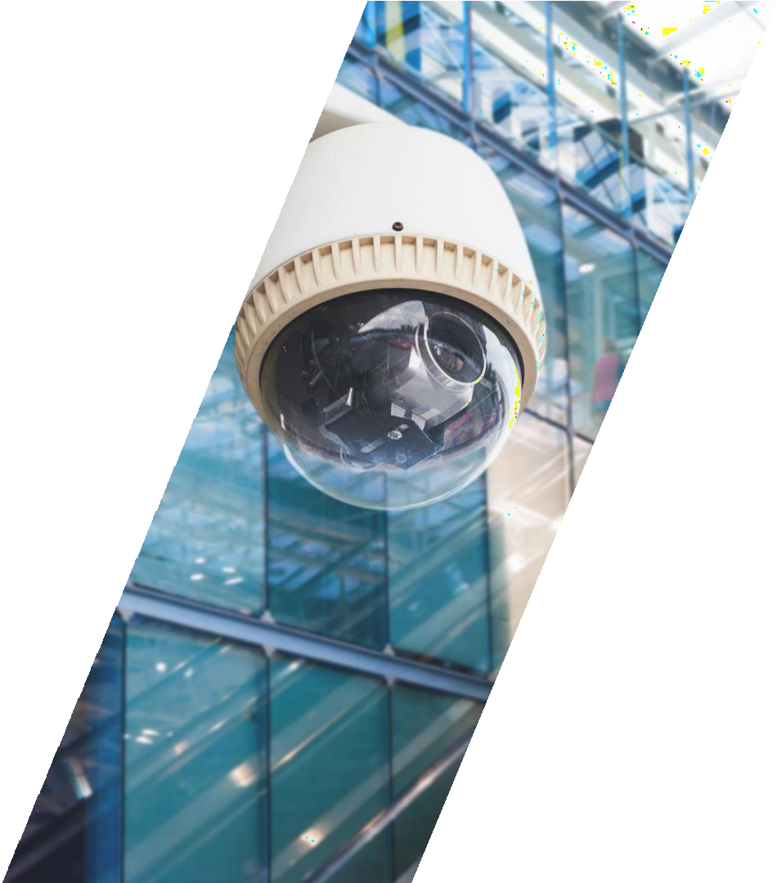









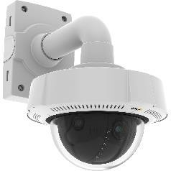
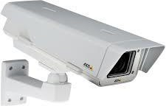
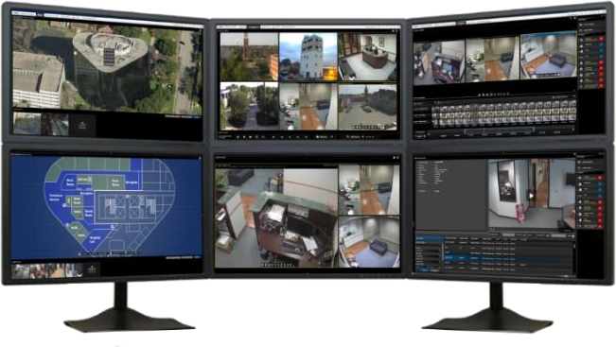
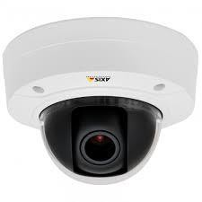
CCTV SURVILLENCE SYSTEM
End to End IP video surveillance solutions
HD CCTV Cameras
Video Analytics (Left object, Loitering, Perimeter
Intrusion etc.)
Video Wall, Display Screens
High End Servers, Work Stations and Storages
Video Management System Software
API, SDK for Integration with Access Control and third
Party System

Slide 11







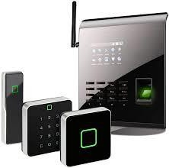
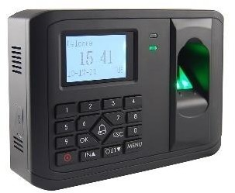
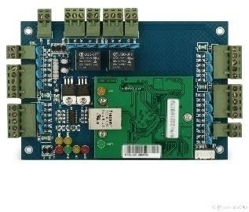
ACCESS CONTROL SYSTEM
We offer Access control solutions ranging from single door stand alone systems to multi door access systems to fully-featured integrated solutions for controlling access to multiple facilities with complex requirements.
Access card reader
Long range reader
Biometric: facial, finger print, palm reader
Access cards: MIFARE, iClass, Proximity etc
Magnetic/Strike locks
Door sensors
Exit buttons-push buttons and infrared types
Access control management and photo badging
software

Slide 12



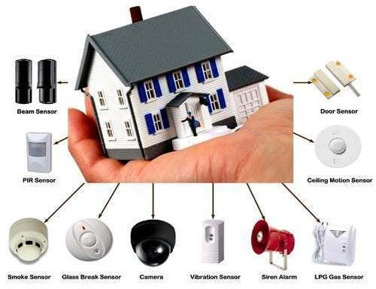
Intrusion Detection, Alarm systems :
Active components
Networking
Sensors
Water leakage
Humidity ,Temp
Controllers

Slide 13



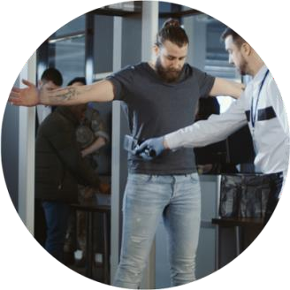

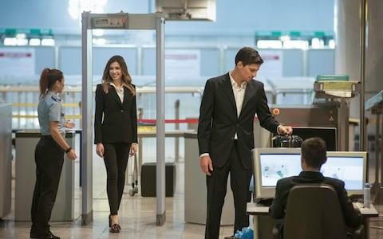
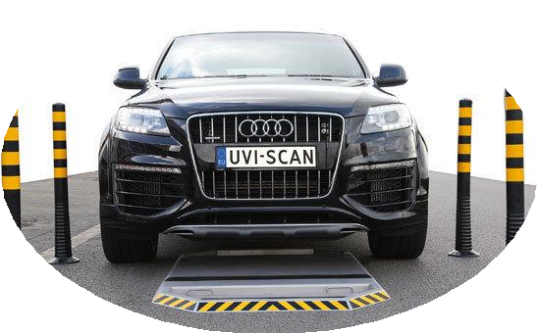
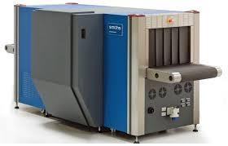
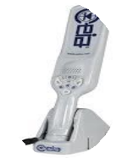
X-RAY INSPECTION & METAL DETECTION SYSTEM
X-ray Inspection/Baggage Scanning System
Walk Through and Hand Held Metal Detectors
Under Vehicle Scanning System

Slide 14




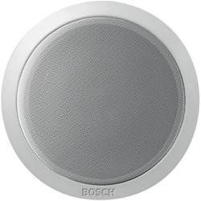
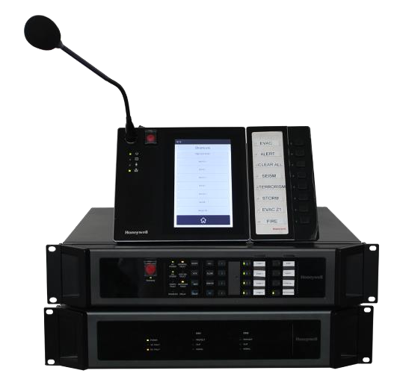
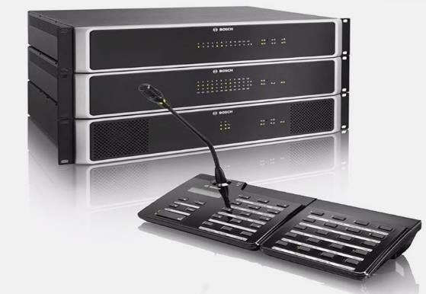
PUBLIC ADDRESS SYSTEM
High-quality public address and voice evacuation solutions suitable for Small Retail to large buildings. We have solutions ranging from simple analogue PA/BGM system to fully digital, networked, public address system using CobraNet technology. We also implement sound reinforcement systems for live music or concert in auditoriums.

Slide 15
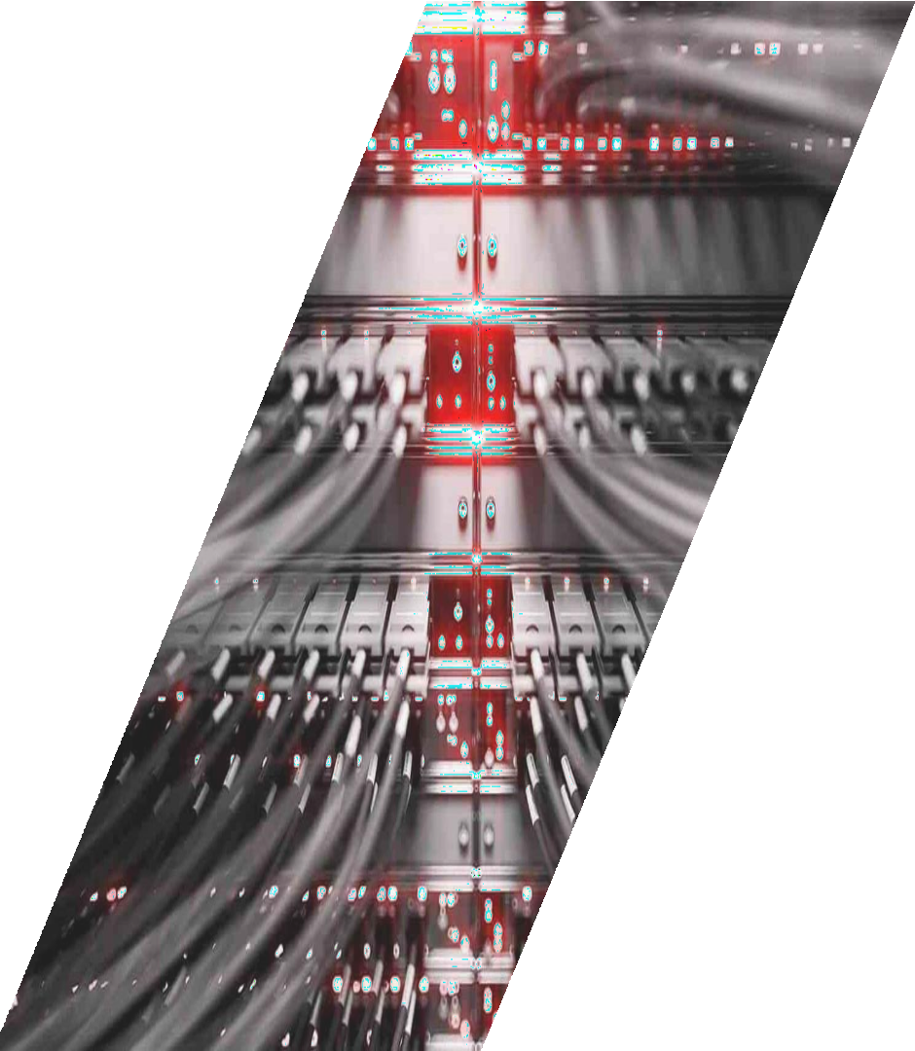




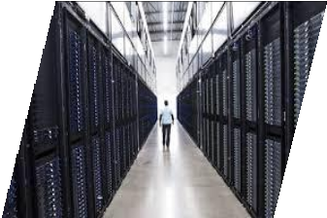

STRUCTURED CABLING
We offer excellence in planning, design, installation, and maintenance of structured network cable infrastructure that is flexible and scalable to your business needs. Whether your requirement is Cat 6, Cat 6A, or Cat 7, we provide end-to-end passive network infrastructure for copper and ﬁber solutions, keeping the TIA/EIA standards in mind.

Slide 16


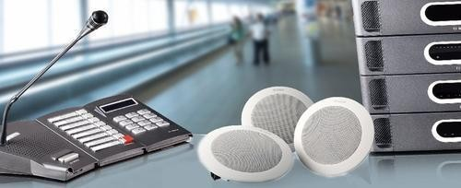
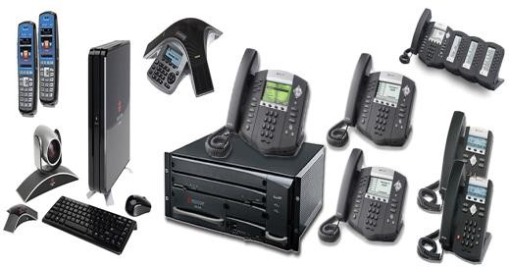
Audio Video Systems
Projectors and screens
Speakers
Source
Telephony:
PABX
IP systems (Switches, Licenses,…)
End points
Cabling
16

Slide 17
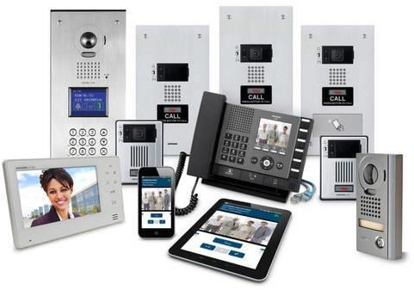
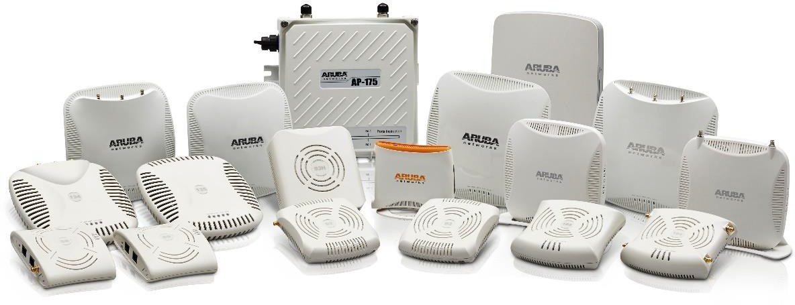

Intercom
Handsets
Audio and video panels
Cabling and switches
Data Wi-Fi
Access points
Switches
Cabling
IPTV and SMATV
Dish farms
Splitters
Multi-switch
Cabling and convectors
Set-up boxes
interface
17

Slide 18

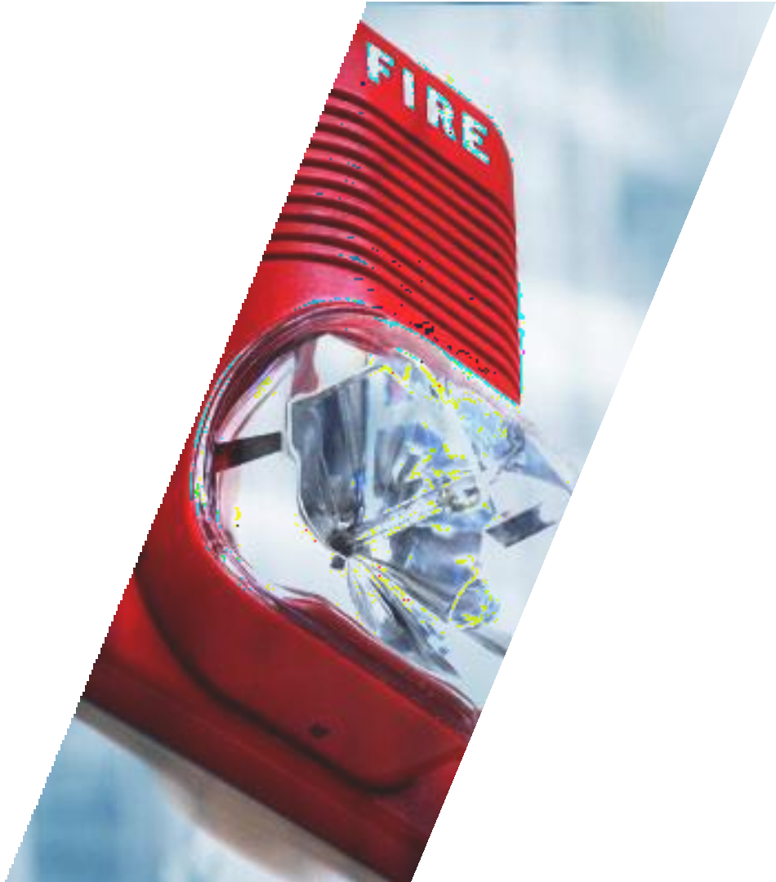

FIRE ALARM SYSTEM
Conventional Fire Alarm System
Addressable Fire Alarm System
Aspirating Smoke Detection (ASD) System
Gas Detection System
Emergency Lighting System
Sectors covered
Residential and commercial buildings
Oil & Gas Sites
Industrial Sites

Slide 19
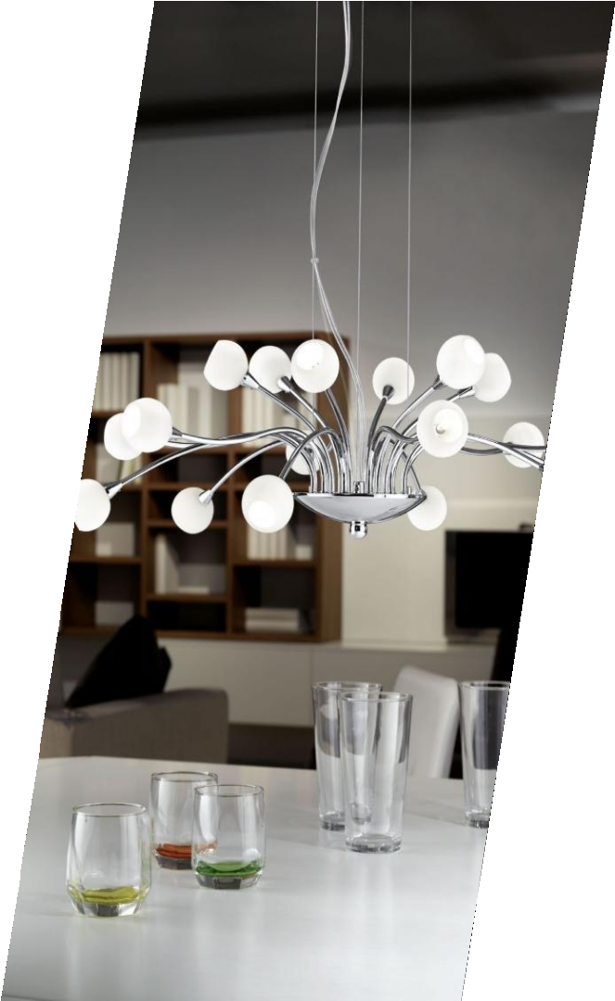








LIGHTING
Our engineering potential and collaboration with leading manufacturers bind the best products and technologies to create an ultimate customer experience.
Architectural Lighting
Façade Lighting
LED Lighting
Stadium Lighting
Street Lighting
Emergency Lighting

Slide 20

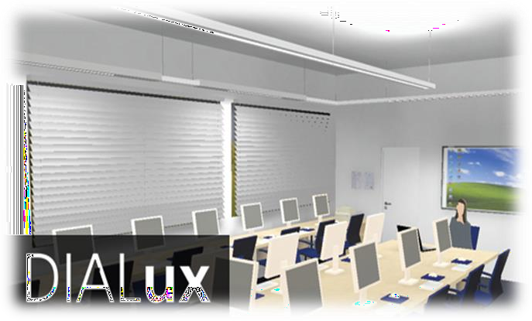

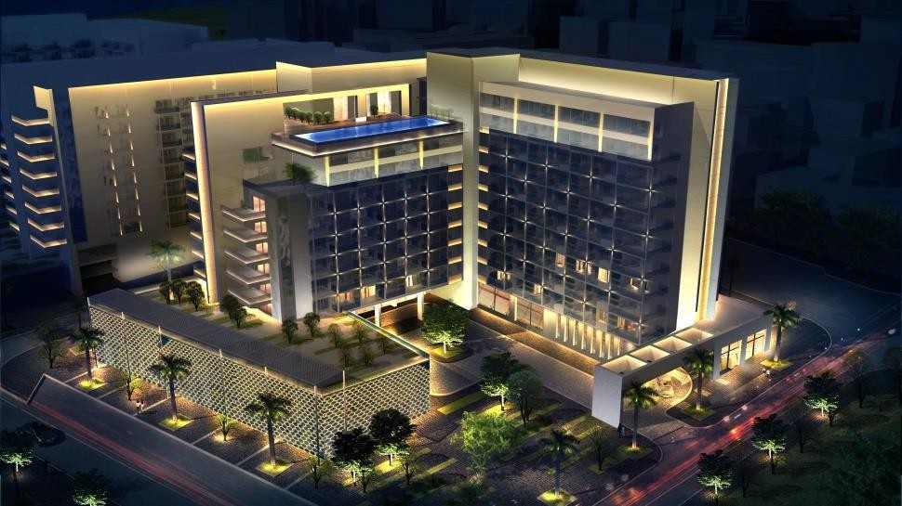
Lighting Services and Solutions
Supply & Installation
Lighting Distribution
Lux Calculations
Indoor Lighting Designs
Landscape Lighting Designs
Façade Lighting Designs
Street Lighting Designs
20

Slide 21
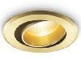
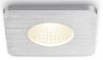
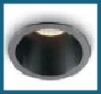
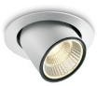
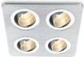
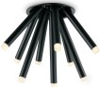
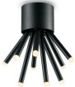
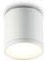
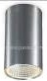
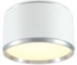
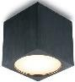
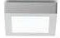
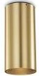
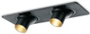
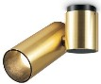

















































































Lighting Products RANGE
Downlight (Recessed / surface mounted)
Spotlight (Track /
surface mounted)
Wall Mounted Luminaires (outdoor)
Wall Mounted Luminaires (INDOOR)
Exit Signs
Panel Lighting Industrial Lighting Step Lights

Slide 22
















































































Lighting Products RANGE
Linear lighting
Bollards
Lighting Poles
Flood Lights
Chandeliers
Ground Recessed
Luminaires

Slide 23







Business Partners

Slide 24









Our Clients

Slide 25

Our Clients

Slide 26



Our Clients

Slide 27


CLIENT : MCV
SYSTEMS IMPLEMENTED BY REMAL:
…..
CLIENT : Giza Palace
SYSTEMS IMPLEMENTED BY REMAL:
……….

Slide 28


CLIENT : Egyption Opera
SYSTEMS IMPLEMENTED BY REMAL:
…..
CLIENT : Granda
SYSTEMS IMPLEMENTED BY REMAL:
……….

Slide 29


CLIENT : Almaza Bay
SYSTEMS IMPLEMENTED BY REMAL:
…..
CLIENT : Coraya Hotel
SYSTEMS IMPLEMENTED BY REMAL:
……….

Slide 30


CLIENT :75375
SYSTEMS IMPLEMENTED BY REMAL:
…..
CLIENT : Kafr Elsheikh Museum
SYSTEMS IMPLEMENTED BY REMAL:
……….

Slide 31


CLIENT :Travco HQ
SYSTEMS IMPLEMENTED BY REMAL:
…..
CLIENT : Sachi
SYSTEMS IMPLEMENTED BY REMAL:
……….

Slide 32
THANK YOU!

